Slide 1
The PolicyCenter User Interface
6 April 2011
Notes:
The PolicyCenter User Interface - <number>
Guidewire training materials contain Guidewire proprietary information that is subject to confidentiality and non-disclosure agreements. You agree to use the information in this manual solely for the purpose of training to implement Guidewire software solutions. You also agree not to disclose the information in this manual to third parties or copy this manual without prior written consent from Guidewire. Guidewire training may be given only by Guidewire employees or certified Guidewire partners under the appropriate agreement with Guidewire.

Slide 2
Lesson objectives
By the end of this lesson, you should be able to:
  Describe the process of logging into PolicyCenter
  Describe the sections of the user interface
  Describe the hierarchy of screens in the user interface
  Describe the functionality for editing data
  Describe the functionality of setting locales
  This lesson uses the notes section for additional explanation and information.
  To view the notes in PowerPoint, choose View→Normal or View→Notes Page.
  If you choose to print the notes for the lesson, be sure to select “Print hidden slides.”
Notes:
The PolicyCenter User Interface - <number>

Slide 3
Lesson outline
Logging in
Sections of the user interface
Screen hierarchy
Editing data
Localization
Notes:
The PolicyCenter User Interface - <number>

Slide 4
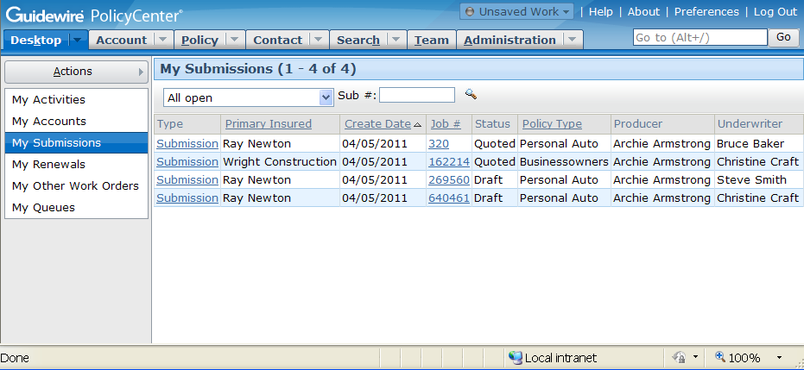
Accessing PolicyCenter
Users must have:
  Internet Explorer
  The PolicyCenter URL
  A user name and password
Notes:
The PolicyCenter User Interface - <number>
To access PolicyCenter, a user must have:
An instance of Internet Explorer
The URL for connecting to PolicyCenter
A valid user name and password
Internet Explorer is the only web browser currently supported by PolicyCenter. PolicyCenter supports version 7.0 and higher.

Slide 5
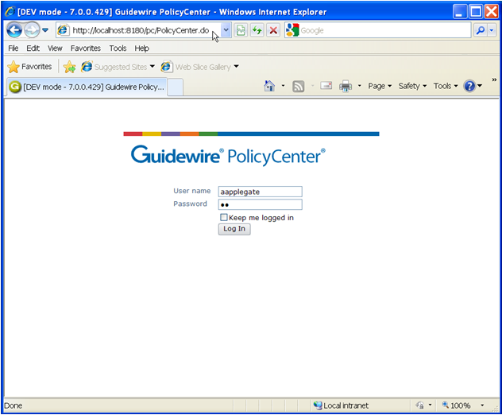
Login page
Because the pages are generated dynamically:
  Back is not supported
  You cannot create Favorites to pages (other than the login page)
Notes:
The PolicyCenter User Interface - <number>
To log in to an application, end users must open an instance of Internet Explorer and access the system through the appropriate URL (Universal Resource Locator, also more commonly known as a "web address"). The URL is:
http://machine:port#/instanceName/PolicyCenter.do, where:
machine is the name of the host machine, and
port# is the port which Internet Explorer should use to access the application, and
instanceName is the name of the instance of PolicyCenter (typically "pc").
Connections to PolicyCenter are usually initiated using one of the following methods:
Providing users with a “Favorite” that links to the URL
Providing users with a shortcut on the computer desktop that invokes Internet Explorer with the URL
Creating a web link on a readily accessible web page that links to the URL
Even though the Back button and favorites to non-login pages are not supported, navigation within PolicyCenter is rarely if ever cumbersome. PolicyCenter contains a number of navigation features to make it easy for users to view commonly referenced information and recently viewed information. These features are discussed through this section.

Slide 6
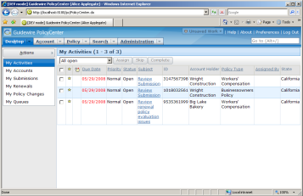
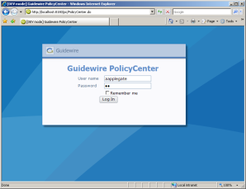

Authentication and authorization
username
and password
Desktop: Activities
authenticated?
what permissions?
which start page?
Yes!
View policy, ...
Desktop: Activities
pc
data
Notes:
The PolicyCenter User Interface - <number>
Authentication is the process of verifying a user is who he or she claims to be. Authorization is the process of determining which objects a user is allowed to view and edit and what actions a user is allowed to take.
When an end user attempts to log on to an application, the following occurs:
The user supplies their user name and password to PolicyCenter via the login page.
PolicyCenter queries the authentication system (which could be a separate system accessed through an integration point or the PolicyCenter database itself) to authenticate the user.
PolicyCenter queries the PolicyCenter database to determine which permissions are assigned to the user and what the user's start page is. Permissions determine which screens the user can navigate to and which actions the user can perform. The startup view is the first page rendered after log in.
PolicyCenter renders the appropriate startup view with permissions appropriate for that user.
Out-of-box, authentication is managed through the PolicyCenter database. There is a table in the database which stores user names and password. (The system can also be configured to authenticate against an existing user domain structure, as discussed on the next slide.)
PolicyCenter can be configured to lock an account after a user attempts to log in a certain number of times without providing the correct password. (This feature is designed to prevent someone circumventing the authentication process to illegal log on to the application.) When an account is locked, it must be unlocked by a manager. In the base application, the number of attempts before locking the account is 3, but this number can be configured.

Slide 7

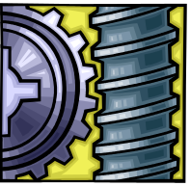
Authentication integration
user name, token or
encrypted password
ID
Authentication
System
authentication
results
Almost every instance is integrated with an authentication system, such as ActiveDirectory
  This system takes a user name and either a token or a password and verifies if the two match
Notes:
The PolicyCenter User Interface - <number>
Information exchange:
PolicyCenter sends the user name and either an encrypted password (if the user is signing on directly to PolicyCenter) or a token (if the user has signed on to another system and is access PolicyCenter via a single sign-on integration point).
PolicyCenter receives information on authentication success or failure
If a user is logging on to PolicyCenter via the login page, then PolicyCenter sends the user name and encrypted password to the authentication system. If a user is logging on to PolicyCenter through some other application which has single sign-on integration with PolicyCenter, then PolicyCenter simply sends the user name and a token.
The effort around planning and configuring this integration point is typically minimal. The data structure of an authentication system is relatively straight-forward, and the amount of information being passed between the two system is small and doesn't change from implementation to implementation.
A given instance of PolicyCenter is typically integrated with a single authentication system.

Slide 8
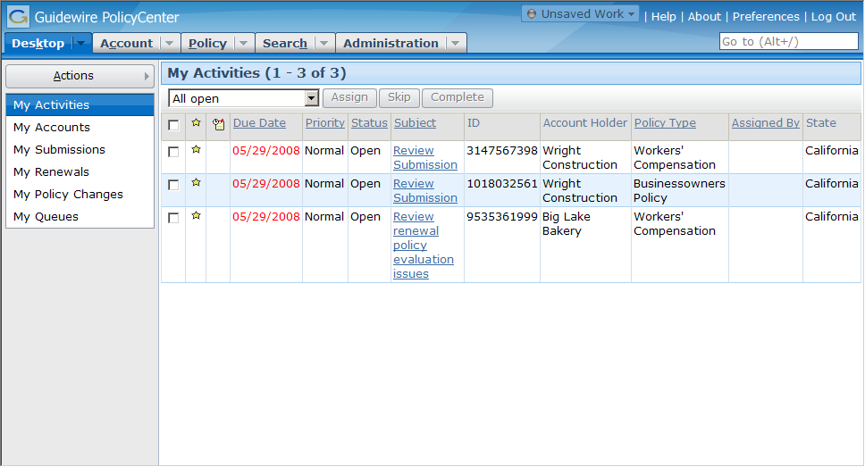
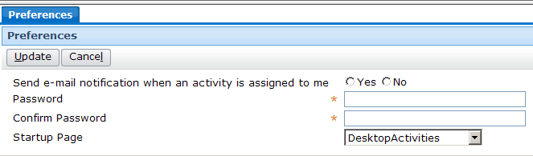
Startup view
Notes:
The PolicyCenter User Interface - <number>
Each user has a startup view, which is what is first displayed when the user logs in. This is sometimes referred to as the user's "landing page".
In the base application, a new user's startup view is set to "DesktopActivities". This page lists all open activities that have been assigned to that user.
Users can change their startup view by clicking the Preferences menu action accessible from the Desktop. This opens a worksheet in the workspace frame. In this worksheet, they can select a different view as their startup view. (The workspace frame displays information that is "stand-alone" from a navigation perspective. The information could be user preferences (which has no impact on business data), or it could be a new note or new activity (which, once created, does not require any change to the data displayed in the screen area). The workspace frame is visible only when a worksheet is rendered. Most of the time, it is collapsed.)
The "look and feel" of PolicyCenter is controlled by a series of cascaded style sheets (CSS). These can be configured if a given instance requires the use of different fonts and/or colors.

Slide 9
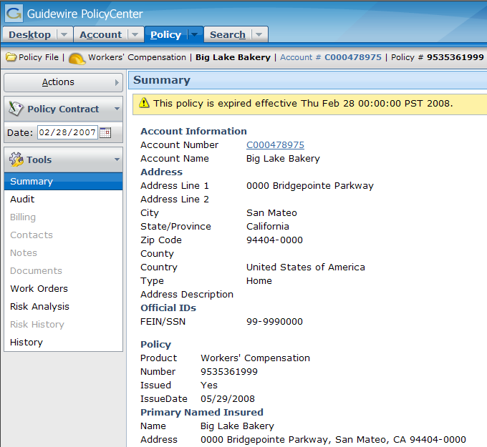
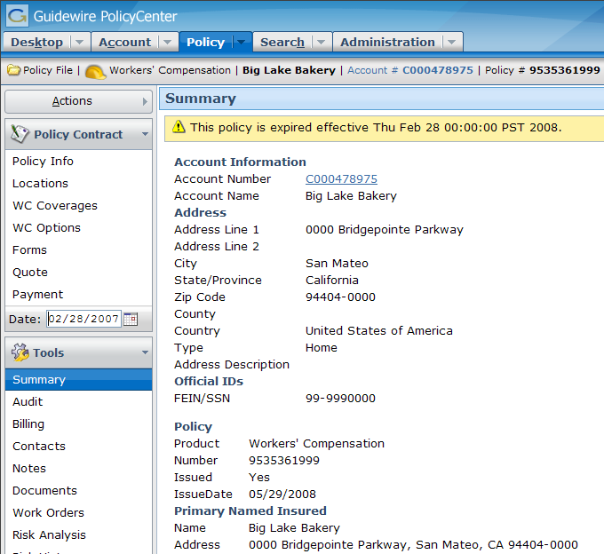
User permissions
Alice Applegate
(Underwriter)
Ida Belt
(Producer Clerical)
Notes:
The PolicyCenter User Interface - <number>
A permission is a granular ability to see or do something within PolicyCenter, such as "create submissions" or "edit accounts".
A role is a named collection of permissions. Typically, a role maps to a job function or job title. For example, the "underwriter" role would contain the set of permissions appropriate to someone who was an underwriter. (This role might, for example, have the "create submissions" or "edit accounts" permissions, but it would not have the "create users" permission. Similarly, a "producer clerical" role might have only "create submissions" and not "edit accounts".)
Administrators can assign roles to users. They can also create new roles and modify existing roles (to add or remove permissions to them).
In Internet Explorer, the name of the user you are logged on as appears in the title bar (the blue bar at the top of the window).
In the example above, Ida Belt (who is a producer clerical user and is shown in the left screenshot) does not have an Administration tab. When viewing a policy, she does not have access to the Policy Contract screens, and many of the Policy Tool screens are unavailable. Alice Applegate (who is an underwriter and is shown in the right screenshot) has access to all of the things just listed.
User permissions are discussed in detail in the "Permissions" lesson.

Slide 10
Lesson outline
Logging in
Sections of the user interface
Screen hierarchy
Editing data
Localization
Notes:
The PolicyCenter User Interface - <number>

Slide 11
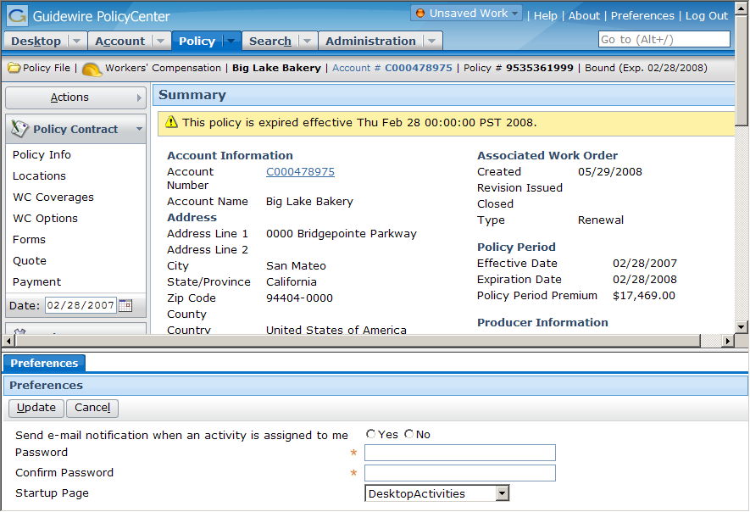
Main areas of the user interface
Info Bar
Tab
Bar
Screen Area
Side Bar
Workspace Frame
Notes:
The PolicyCenter User Interface - <number>
The PolicyCenter user interface can be broken down into the following main areas.
The tab bar is the top portion of the screen. It contains the tabs, a series of tab bar links (such as "Help" and "About") and the Guidewire logo.
The info bar is the horizontal gray strip between the tab bar and the screen area. It is not always visible. (In the base application, it is visible only on the Account and Policy tabs.) When it is visible, it contains summary information about the primary object displayed in the screen area.
The side bar is the vertical bar running down the left side of the user interface. The side bar contains menu links and menu actions that navigate the user to different parts of the application and let the user create new objects and initiate new jobs.
The screen area is the rectangular area to the right of the side bar. When the workspace frame is collapsed, the screen area occupies the lower right corner of the user interface. This is where the majority of the business data is displayed and acted upon.
The workspace frame displays information that is "stand-alone" from a navigation perspective. The information could be user preferences (which has no impact on business data), or it could be a new note or new activity (which, once created, does not require any change to the data displayed in the screen area). The workspace frame is visible only when a worksheet is rendered. Most of the time, it is collapsed.

Slide 12
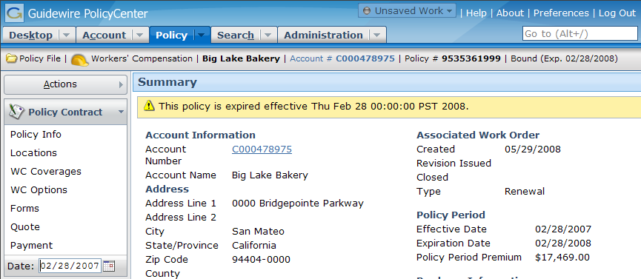
Tab bar
Collection of tabs and tab bar links
Each tab has:
  Its own side bar and its own info bar
  One major area of functionality
Notes:
The PolicyCenter User Interface - <number>
The tab bar is the top portion of the screen. It contains tabs, a series of tab bar links (such as "Help" and "About") and the Guidewire logo.
Each tab has its own side bar, its own info bar (though in some cases it is hidden) and its own set of screens (which are displayed in the screen area). When you click a tab, the associated side bar, (the associated side bar if it is visible,) and one of its screens are displayed.
The tabs shown above are the tabs that underwriters have access to when they first log into PolicyCenter. There can be additional tabs (such as Team) that are available only to users with permissions greater than that of an underwriter.

Slide 13
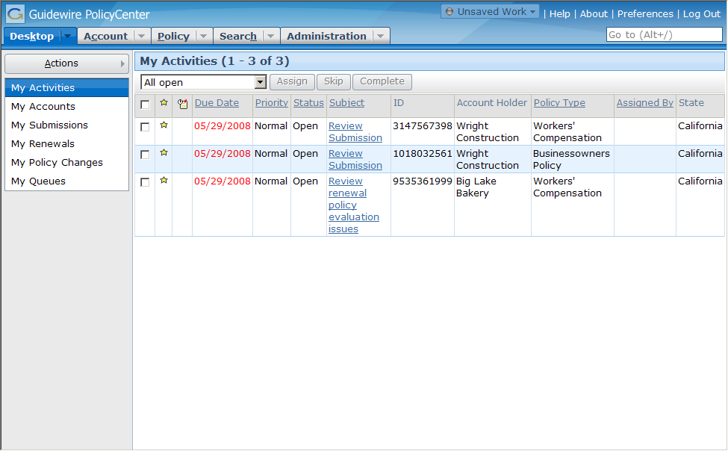
Desktop tab
User-centric, listing work you as the user are responsible for (regardless of which account or policy it pertains to)
Notes:
The PolicyCenter User Interface - <number>
The Desktop tab is a series of lists of objects for which the user has some responsibility, including:
Activities assigned to the user.
Accounts on which the user has a role, has an assigned activity, or has closed an activity.
Submissions on which the user has a role, has an assigned activity, or has closed an activity.
Renewals on which the user has a role, has an assigned activity, or has closed an activity.
Policy changes on which the user has a role, has an assigned activity, or has closed an activity.
Queues the user has access to (which contain activities that no user has taken ownership of yet)

Slide 14
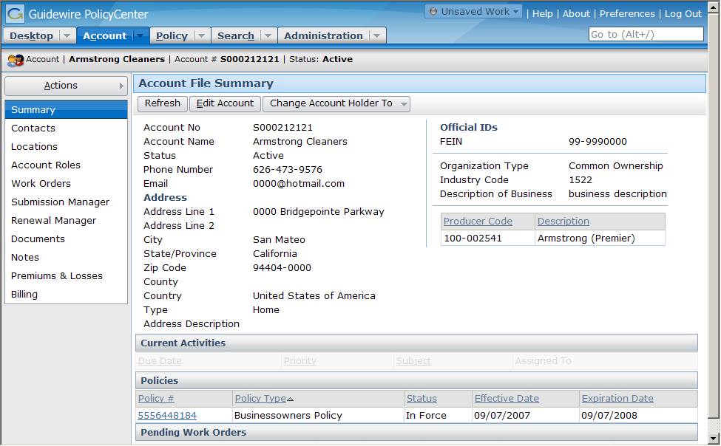
Account tab
Account-centric, listing work for this account (regardless of who is doing the work)
Notes:
The PolicyCenter User Interface - <number>
The Account tab contains a series of screens about one account, list both information about the account itself, its contacts and locations, the policies held by the account, and policy transactions for the account which are in progress (such as submissions and renewals).

Slide 15
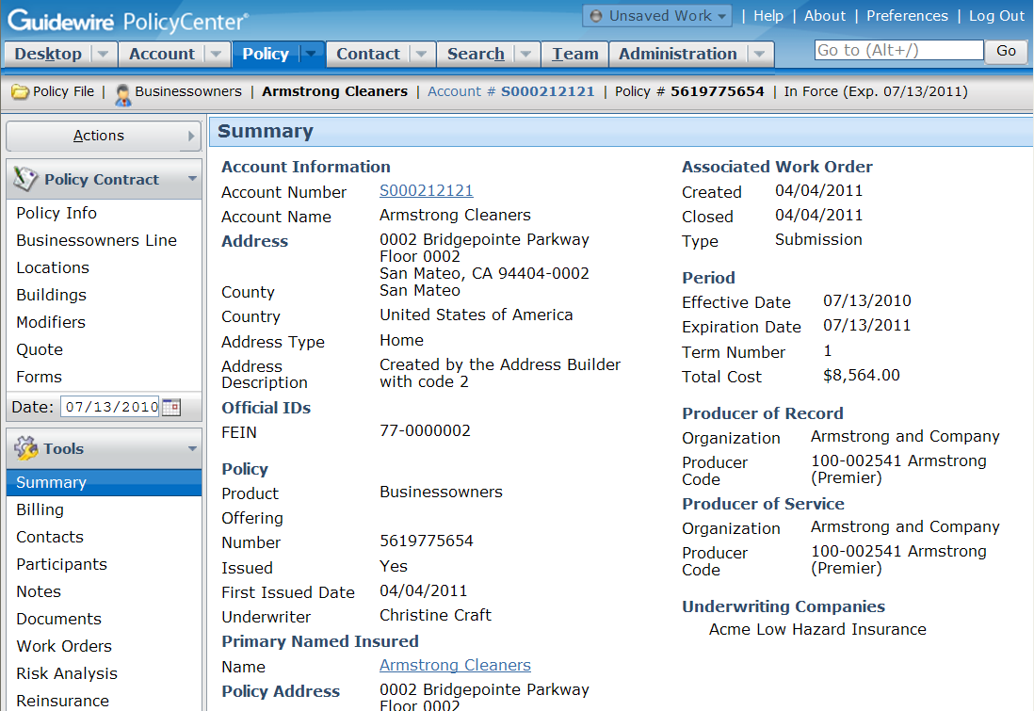
Policy tab
Policy-centric, listing work for this policy (regardless of who is doing the work)
Notes:
The PolicyCenter User Interface - <number>
The Policy tab contains the "policy file", a series of screens about one policy. This includes both the "policy contract" data (what is covered on the policy) and the "policy tools" data (what historical information is available about the work done on the policy, such as notes, bills, risk analysis, and so on).

Slide 16

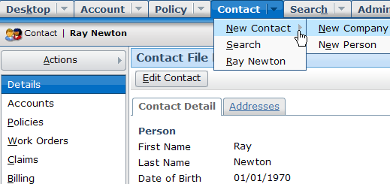
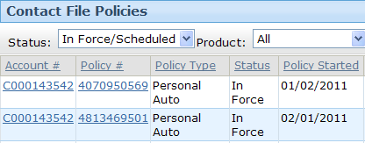

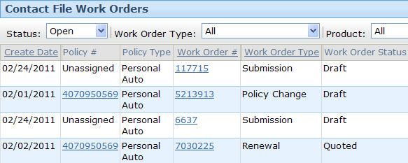
Contact tab
360 degree view of a client across Guidewire Suite
  Start work from Contact tab
Notes:
The Contact tab provides a user the ability to work from a contact-centric starting point. A contact file is maintained similar to account and policy files so that configuration users can easily expand this functionality as needed.
A user can:
Edit contact information
Create new accounts with this contact
Create new contacts of type person or company
Search for contacts the same way as they can search for an account or a policy
View and link to accounts, policies, and work orders associated with the contact. There are filters on each of the pages to view policy or work order of a particular status or product type.
The Addresses tab displays a list-detail view of addresses of the Contact.
Users can also view contacts that only exist externally through the Contacts tab but these contacts are not editable within PolicyCenter.
Management and Integration - <number>

Slide 17
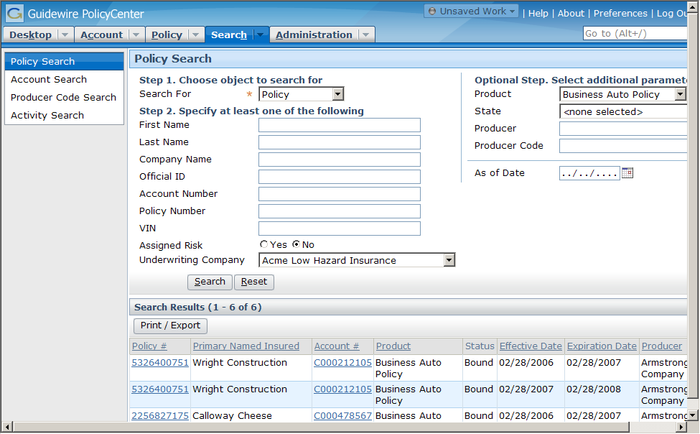
Search tab
Text fields are treated as "starts with" conditions
Notes:
The PolicyCenter User Interface - <number>
The Search tab gives users the ability to search for different types of objects, specifically:
Policies
Accounts
Producer Codes
Activities
Contacts
Some fields on search screens are text fields. Whenever you enter text into one of these fields, PolicyCenter treats the field as a "starts with" criteria. For example, if you entered "Smith" into the last name field, then the search will return any user whose last name starts with 'Smith', which includes "Smith", "Smithers", and "Smith-Collins".

Slide 18
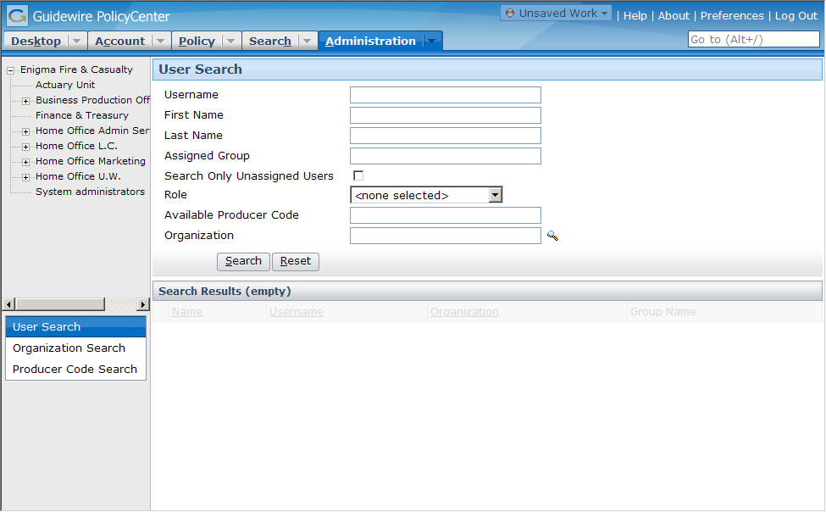
Administration tab
Used to search for users, groups, and producers
  Additional functionality for supervisor and administrator users
Notes:
The PolicyCenter User Interface - <number>
The Administration tab is used by underwriters to search for information about the carrier and how it does business (such as PolicyCenter users or producers and their codes). The Administration tab is used by supervisors and administrators to complete system management tasks (such as creating users and groups, modifying user permissions, and importing data).

Slide 19
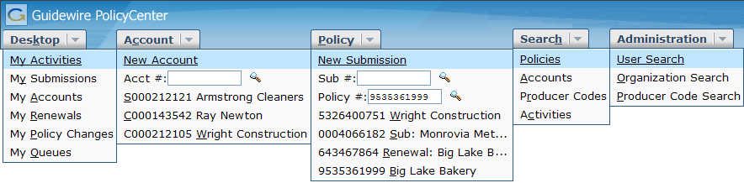

Tab menus
Tabs usually have menus with shortcuts to screens on that tab
Account and Policy tabs have:
  Menu items to create new accounts and submissions
  Special search widgets for accounts, submissions, and policies
Notes:
The PolicyCenter User Interface - <number>

Slide 20
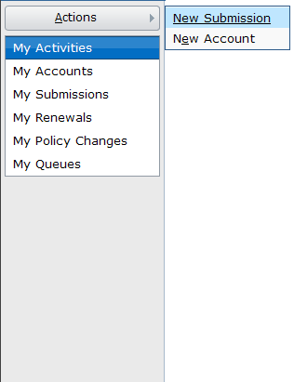
Side bar
Menu links display new screens in screen area
Menu actions execute actions (which often display screens in the screen area or workspace frame)
menu
actions
menu links
Notes:
The PolicyCenter User Interface - <number>
The side bar is the vertical gray bar running down the left side of the user interface. The side bar contains menu links and the Actions menu, which has embedded menu actions that navigate the user to different parts of the application and let the user create new objects and initiate new jobs.
The behavior described above is true for base application menu links and menu actions. However, any clickable item can be configured to behave in any manner.

Slide 21
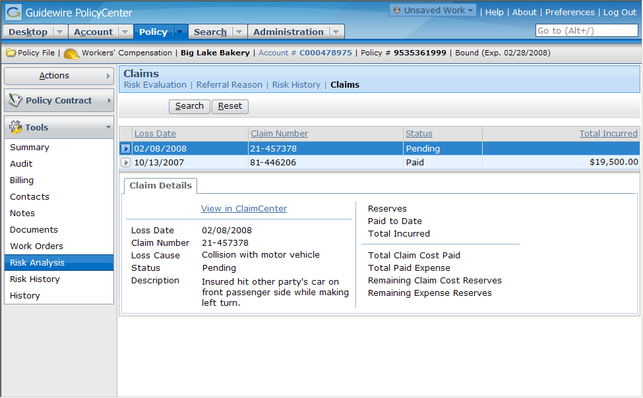
Screen area
Screen links
Notes:
The PolicyCenter User Interface - <number>
The screen area is the rectangular area to the right of the side bar. When the workspace frame is collapsed, the screen area occupies the lower right corner of the user interface. This is where the majority of the business data is displayed and acted upon.
End users typically navigate to a given screen (that is, they cause a screen to be rendered in the screen area) by clicking the appropriate tab and then clicking the appropriate menu link and/or screen link.

Slide 22
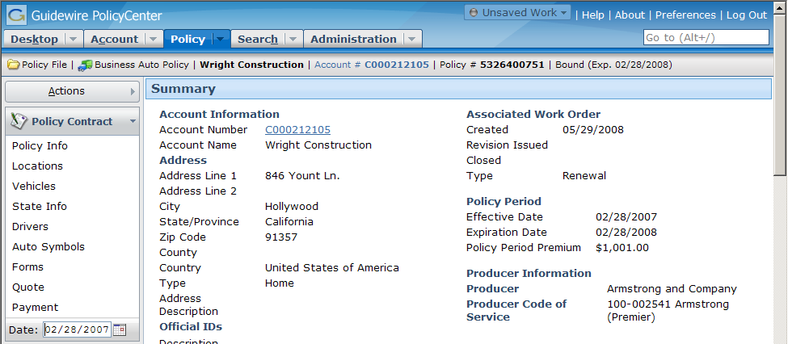
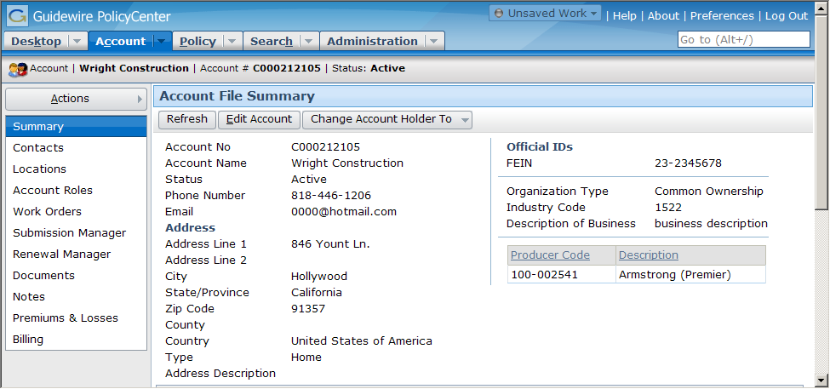
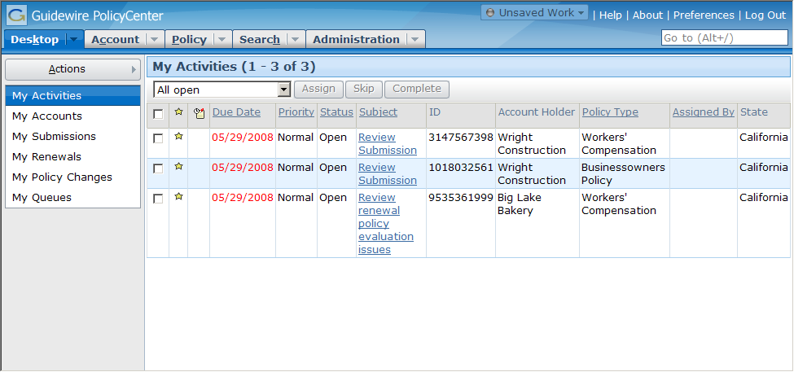
Info bar
Notes:
The PolicyCenter User Interface - <number>
The info bar is the gray strip of UI real estate between the tab bar and the screen area.
The info bar can be visible for some tabs and hidden for others. In the base application, the info bar is visible only for the Account and Policy tabs. It contains summary information about the account or policy.

Slide 23
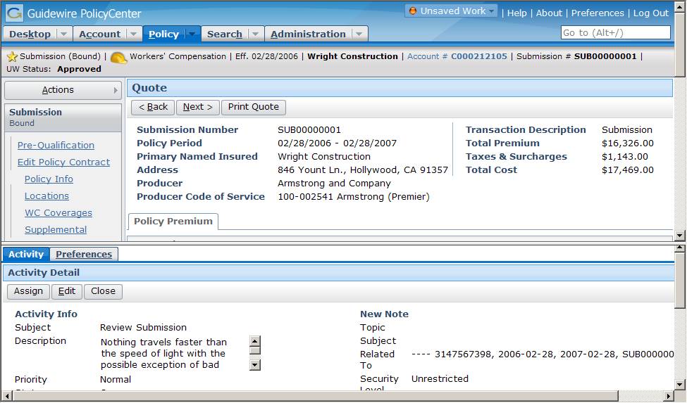
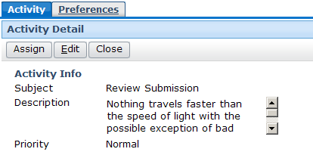
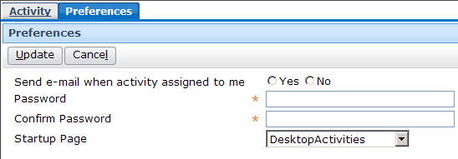
Workspace frame
Resizable
Notes:
The PolicyCenter User Interface - <number>
The workspace frame displays information that is "stand-alone" from a navigation perspective. The information could be user preferences (which has no impact on business data), or it could be a new note or new activity (which, once created, does not require any change to the data displayed in the screen area). The workspace frame is visible only when a worksheet is rendered. Most of the time, it is collapsed.
The workspace frame is resizable. You can adjust the height by dragging the horizontal bar that separates the side bar and screen area from the workspace frame.
Worksheets can have a "scope", which identifies what must be displayed in the screen area in order for the worksheet to be displayed. When the object is displayed in the screen area, the worksheet is visible. When the object is not displayed, the worksheet is not visible. This means that worksheets can appear and disappear (without explicitly being dismissed by the user) as the user moves from one top-level tab to another.

Slide 24
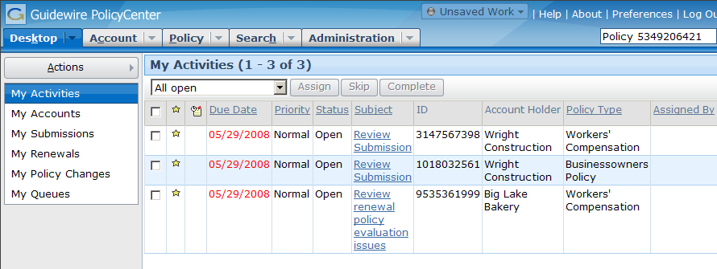
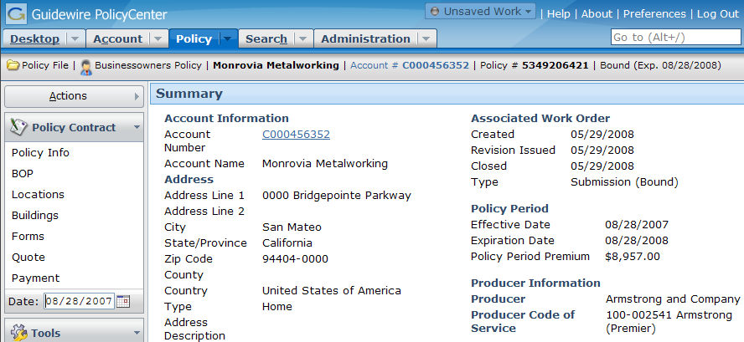
"QuickJump" field
ALT+/, and then
"Policy 5349206421"
and then Enter
Notes:
The PolicyCenter User Interface - <number>
The QuickJump field is located in the upper-right corner of the user interface, though it can be accessed using a keyboard shortcut as well. The QuickJump field is designed to let users navigate to virtually any place in PolicyCenter without having to use their mouse.
For example, to navigate to policy 5349206421, a user could enter ALT+/ (to activate the QuickJump field) and then "Policy 5349206421 " and then Enter. This navigates the user to that policy.

Slide 25
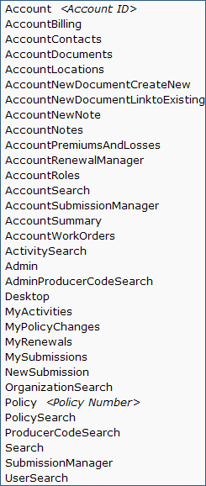
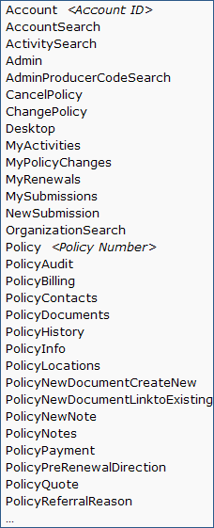
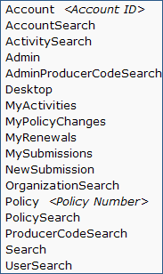
Options for the "QuickJump" field
Desktop, Search, Admin
Valid QuickJump options vary based on active tab
Notes:
The PolicyCenter User Interface - <number>
The valid set of character strings that can be entered in the base application's QuickJump field depends on which tab the user is on.
The QuickJump box is configurable. Developers can remove existing QuickJump strings, modify the spelling for existing strings, and create new ones.

Slide 26

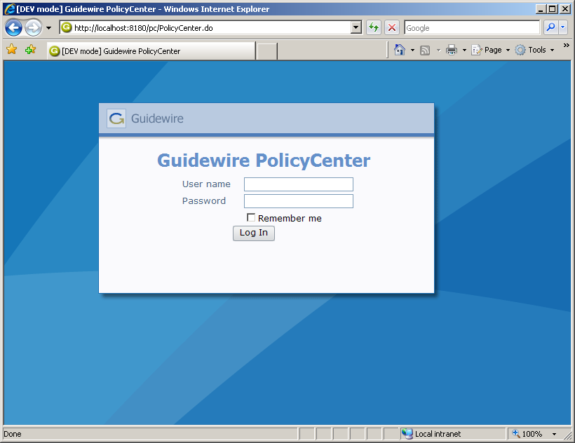
Logging out
After configured period of inactivity, OR
when you click...
Notes:
The PolicyCenter User Interface - <number>
When a user is finished interacting with PolicyCenter, he or she can log out using the Logout link.
The timeout period can be configured in the config.xml file. The default value is 10800 seconds (3 hours).

Slide 27
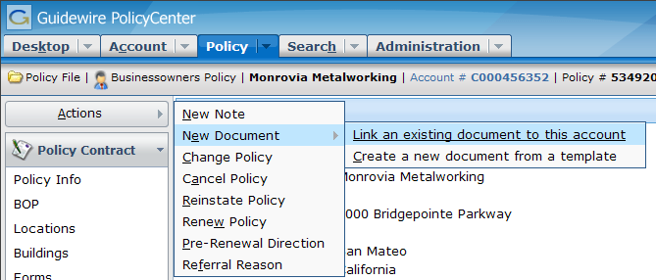
Keyboard shortcuts
Activating shortcut is equivalent to clicking item
To activate shortcut, enter
ALT + the_underlined_letter
Notes:
The PolicyCenter User Interface - <number>
All keyboard shortcuts specific to PolicyCenter must start with the ALT key. Keyboard shortcuts specific to PolicyCenter cannot start with the CTRL key, as that key is already "owned" by Internet Explorer. (For example, CTRL + N opens a new Internet Explorer window. This sequence cannot be used by PolicyCenter.)
Keyboard shortcuts have a precedence, with the shortcuts in the "active" part of the user interface taking precedence over the shortcuts at the "inactive" parts. For example, as shown above, the Account tab, the "Change Policy" menu item, and the "Create a new document..." menu link both have a shortcut of "c". Because the submenu is currently active, the ALT + C shortcut with create a new document.
Keyboard shortcuts can be reconfigured. For example, if the legacy system had a keyboard shortcut for searches which was ALT + C, then the Search shortcut, which is ALT + H in the base application, could be reconfigured to be ALT + C.
There is also a series of global shortcuts. These shortcuts can be used at any time, regardless of where in the application the user has navigated to. A list of the shortcuts can be displayed by clicking the Help link in the tab bar.

Slide 28
Lesson outline
Logging in
Sections of the user interface
Screen hierarchy
Editing data
Localization
Notes:
The PolicyCenter User Interface - <number>

Slide 29



Elements of a screen
Screen
Secondary View
Primary View
Primary View
atomic
widgets
atomic widgets
Notes:
The PolicyCenter User Interface - <number>
The screen hierarchy describes the levels of information in the screen area (and workspace frame) and the level at which one navigates to that information. It consists of four levels, described below from the lowest to the highest.
The atomic widget level is the most granular level of the user interface. It is the level of individual units of data (such as text, dates, and yes/no values) and individual units of functionality (such as buttons or menu items).
The primary view level is the level at which atomic widgets are organized to display information about a single object (and data related to that object) or a single set of objects. Detail views are the views used for the single-object approach. List views are the views used for the set-of-objects approach.
The secondary view level is the level at which primary views are organized to display information in a format usable to the end users. Card views are used to group different detail and list views so that any view one can easily be accessed but only one view is visible at a time. Listdetail views are used to quickly display complex information about any given object within a set of objects.
The screen level is the level which organizes all data which should be displayed at one time (or in other words, one large area of functionality). The information in a screen occupies the entire screen area or workspace frame.
A navigation widget is a widget that, when clicked, causes new information to be rendered in the screen area (or workspace frame). Navigation involves the rendering of one or more screens.

Slide 30

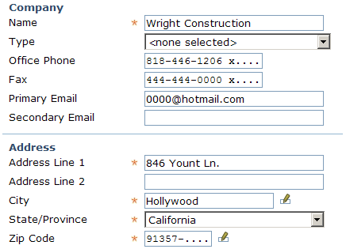
Atomic widgets
cell
button
field
Atomic piece of user interface content or functionality (a field, cell, button, or static
label)
static label
Notes:
The PolicyCenter User Interface - <number>
The majority of atomic widgets appear in detail views, list views, or on toolbars. Atomic widgets do also appear in the tab bar and the side bar. However, these represent probably less than 20% of the atomic widgets in the PolicyCenter base application.
Within the Guidewire user interface architecture, fields are commonly referred to as "inputs". This is because they are created using an element known as an "input".

Slide 31
Primary views
List
View
Detail
View
Organize atomic widgets that display information about one object or one set of objects
  Two types of primary views: detail and list
Notes:
The PolicyCenter User Interface - <number>

Slide 32
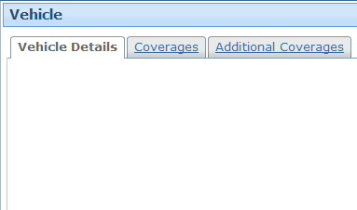
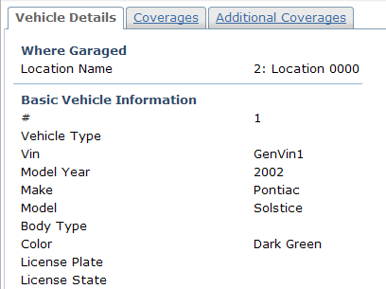
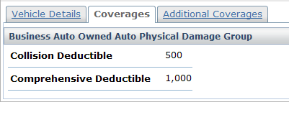
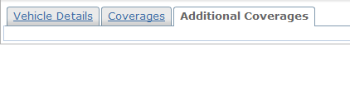
Secondary views: Card view
Collection of cards
  Each card contains detail view, list view, card view, or listdetail view
Notes:
The PolicyCenter User Interface - <number>
In the example above, the card view is a collection of three detail views.
A card can also contain more than one view. For example, a single card could have two detail views or a detail and a list view.

Slide 33
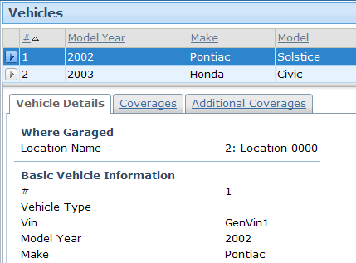
Secondary views: Listdetail view
List on top
"Details" of selected row on bottom
Contains list on top with one object selected and "details" about that object on the bottom
  "Details" could be a detail view, list view, card view, or embedded listdetail view
Notes:
The PolicyCenter User Interface - <number>
In the example above, the listdetail view is a collection of two views:
A list view (the list of vehicle on top)
A card view (a set of three detail views, each on their own card, on the bottom)

Slide 34
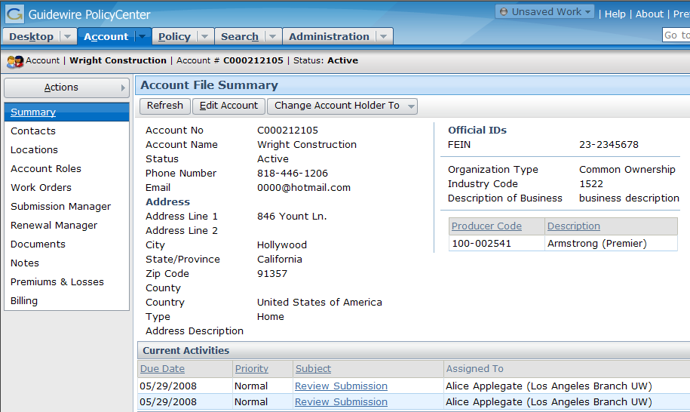
Screens
Entire contents of screen area (or workspace frame)
Notes:
The PolicyCenter User Interface - <number>

Slide 35
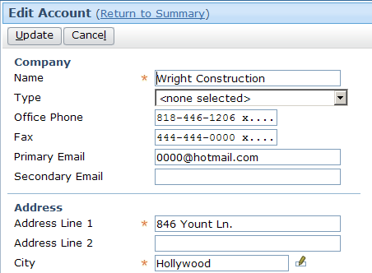
Screen navigation
Act of rendering a new screen (or set of screens)
Notes:
The PolicyCenter User Interface - <number>
A navigation widget is an atomic widget which is clickable and which causes one or more new screens to be rendered when clicked. Navigation is a property that almost any atomic widget can have.
A navigation specifies:
Which screen or screens to display
Where to display them
Whether the previous "location" should be remembered so that the user can be returned there when the work on the current screen is done

Slide 36
Review: Screen hierarchy
Navigation
screen
a top-level container
one can navigate to
Screen
secondary views
collections of primary views organized for usability
Card View / ListDetail View
primary views
a single object (and its related data) or set of objects
Detail
View
List
View
atomic widgets
individual elements of data and/or functionality
Atomic Widgets
Notes:
The PolicyCenter User Interface - <number>

Slide 37
Lesson outline
Logging in
Sections of the user interface
Screen hierarchy
Editing data
Localization
Notes:
The PolicyCenter User Interface - <number>

Slide 38
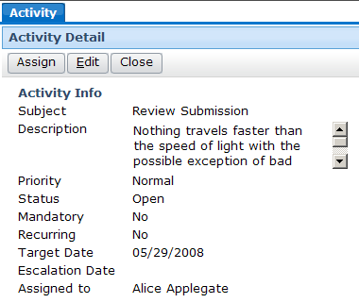
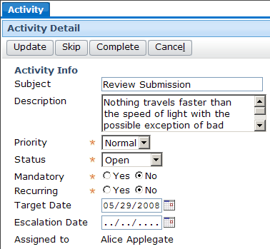
Edit modes
editable
read-only
Screen has two "edit modes": read-only and edit
Notes:
The PolicyCenter User Interface - <number>
When a screen is put into edit mode, the widgets that can be edited become editable. In some cases, a widget is not editable even if the screen is in edit mode. This is common when:
The business process doesn't allow the widget value to be changed at this point (such as the product field for a submission, which is set when the submission is first created and cannot be modified after the submission is started).
The user doesn't have sufficient permission to edit the widget (such as a status field (open or closed) for an activity that is not owned by the given user).
There is a separate mechanism for modifying the widget value (such as an Underwriter field for a submission, which is set by reassigning the submission).

Slide 39
Read-only mode
Widget values cannot be modified
Depending on functionality and permissions, Edit button may be available
Notes:
The PolicyCenter User Interface - <number>
Every screen does not always have a toolbar with an Edit button when in edit mode. Some screens are designed to always be read-only (such as the History screen). Consequently, the Edit button appears only if:
The screen has been configured to be editable, and
The user has sufficient permissions to put the screen in edit mode.

Slide 40
Edit mode
Some (or all) widget values can be modified
Update button and Cancel button
Notes:
The PolicyCenter User Interface - <number>
Editability can be controlled at many levels, including the screen level and the widget level. In order for a widget to be editable, the screen must be in edit mode and the widget must be editable. If a screen is in edit mode, then any of its widgets which are editable can be modified (such as the Description field shown above). However, if a widget is set to read-only (such as the Assigned To field shown above), then it will always be read-only, regardless of the screen mode.
If a screen is in Edit mode, it should always have Update and Cancel buttons.

Slide 41
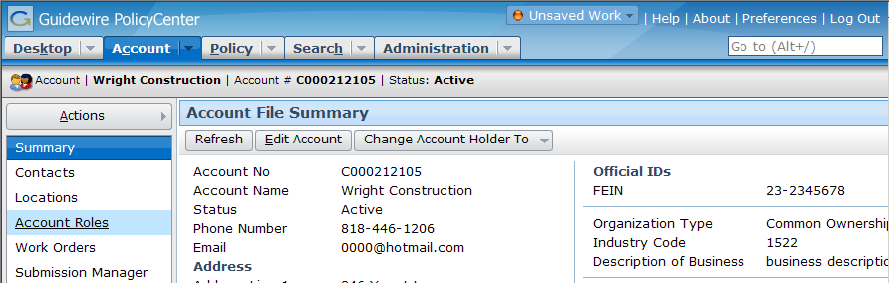
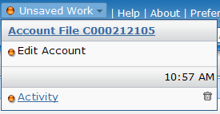
Unsaved work menu
All of your unsaved work is automatically listed in the Unsaved Work menu
Notes:
The PolicyCenter User Interface - <number>
"Unsaved work" refers to either work in a screen for a new object which you created but did not save or work in a screen for an existing object which you put into edit mode without updating or cancelling. In other words, unsaved work refers to any work which you navigated away from without clicking the Update or Cancel buttons.
All of your unsaved work is automatically listed in the Unsaved Work menu.
From the Unsaved Work menu, you can either navigate to the screen where the unsaved work is (by clicking the link) or discard the work (by clicking the corresponding trash icon).
If you attempt to log off with unsaved work, you are warned that all unsaved work will be discarded. If you click Ok, then all unsaved work is discarded.
The Unsaved Work menu is available only when you have unsaved work. If the menu is unavailable, then you have Updated or Canceled all changes you have made so far.

Slide 42
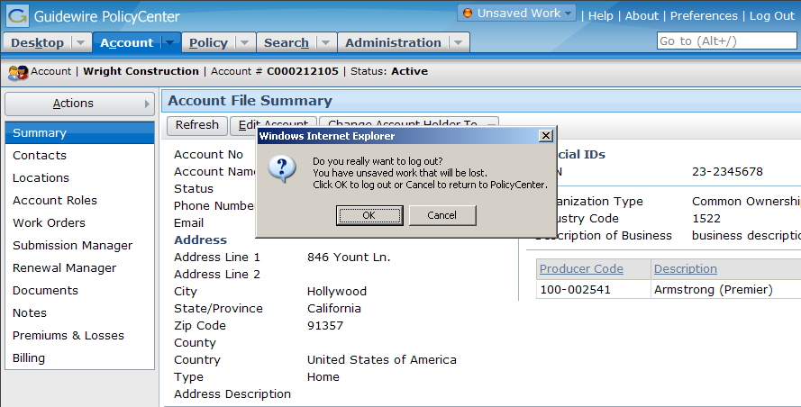
Logging off with unsaved work
If user attempts to log out and there is unsaved work...
... user must verify it is okay to discard unsaved work.
Notes:
The PolicyCenter User Interface - <number>
If the user inadvertently closes the web browser (without formally logging off) and he or she reconnects to the server immediately, all unsaved work should be preserved. However, if the user does not reconnect immediately, the session may time out. When a session times out, all unsaved work is discarded.

Slide 43
Lesson outline
Logging in
Sections of the user interface
Screen hierarchy
Editing data
Localization
Notes:
The PolicyCenter User Interface - <number>

Slide 44
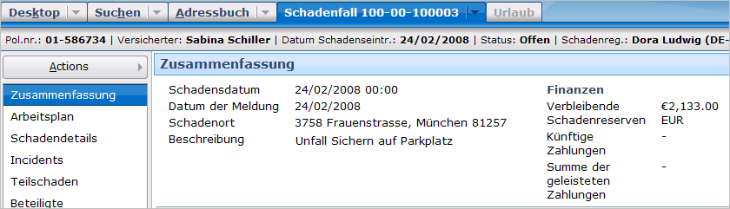
Localization
A locale can define how various elements of the UI are presented, including
  Currency formats
  Date/time formats
  Number formats
  Text labels
Notes:
The PolicyCenter User Interface - <number>
The example shown above comes from ClaimCenter, but the capability to localize the interface is identical for all Guidewire applications.

Slide 45
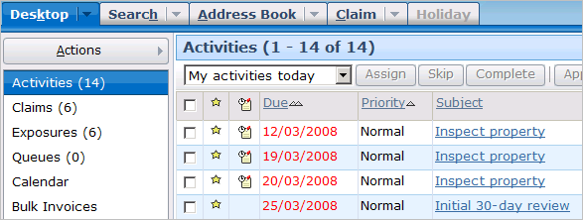


Setting user locale
Language and locale preference can be set per user
  At logon
  Via preferences
Notes:
The PolicyCenter User Interface - <number>
The example shown above comes from ClaimCenter, but the capability to localize the interface is identical for all Guidewire applications.

Slide 46
Lesson objectives review
You should now be able to:
  Describe the process of logging into PolicyCenter
  Describe the sections of the user interface
  Describe the hierarchy of screens in the user interface
  Describe the functionality for editing data
  Describe the functionality of setting locales
Notes:
The PolicyCenter User Interface - <number>

Slide 47
Review questions
When a user attempts to log into PolicyCenter, the PolicyCenter database is queried for what three pieces of information?
Name two ways in which the user interface could look different for users with different permissions.
Name two differences between the screen area and the workspace frame.
In the base application, how many different side bars can a user with adjuster permissions see?
Within PolicyCenter, how do you go back to a screen you previously viewed?
When a navigation occurs, what level of the user interface does the system navigate to?
Name two ways a user could identify if they have any unsaved work.
Notes:
The PolicyCenter User Interface - <number>
Answers
1. Whether or not the user can be authenticated, what are the user's roles (permissions), and what is the user's startup page.
2. Possible answers:
A given tab might be visible or not visible.
A given menu link might be visible or not visible.
A given menu action may have fewer or more menu items within it.
3. Possible answers:
The screen area is always visible, whereas the workspace frame appears only if something is rendered within it.
The screen area contains the majority of the business data, whereas the workspace frame contains data that is navigationally distinct from the screen area.
If the screen area contains multiple sets of information, each is accessed via a "screen link" link and all screen link links are always visible, whereas if the workspace frame contains multiple sets of information, each is accessed via a tab and that tab may or may not always be visible depending on what is displayed in the screen area.
4. Five. An underwriter can access five tabs (Desktop, Account, Policy, Search, Administration), and each tab has its own side bar.
(continued)

Slide 48

(Notes only slide)
Notes:
The PolicyCenter User Interface - <number>
5. In PolicyCenter, the Internet Explorer Back button is not supported. This is due to limitations with Internet Explorer and the fact that PolicyCenter is a series of dynamic HTML pages (as opposed to static HTML pages). In most cases, to view a screen previously viewed, you must re-navigate to it. Fortunately, there are a large number of shortcuts (such as the list of recently viewed Accounts or Policies in the Account and Policy tab menus respectively). Consequently, viewing a previously viewed screen is typically only a few clicks away.
6. Navigations navigate to the screen level.
7. The Unsaved Work menu is available only when there is unsaved work. If a user attempts to log off PolicyCenter and there is unsaved work, a dialog box alerts them to this fact.

Slide 49
Notices
Copyright © 2001-2011 Guidewire Software, Inc. All Rights Reserved.
Guidewire, Guidewire Software, Guidewire ClaimCenter, Guidewire PolicyCenter, Guidewire BillingCenter, Guidewire Reinsurance Management, Guidewire ContactManager, Guidewire Vendor Data Management, Guidewire Client Data Management, Guidewire InsuranceSuite, Guidewire ContactCenter, Guidewire Studio, Gosu, Deliver Insurance Your Way, and the Guidewire logo are trademarks or registered trademarks of Guidewire Software, Inc. in the United States and/or other countries.
This material is Guidewire proprietary and confidential. The contents of this material, including product architecture details and APIs, are considered confidential and are fully protected by customer licensing confidentiality agreements and signed Non-Disclosure Agreements (NDAs).
This file and the contents herein are the property of Guidewire Software, Inc. Use of this course material is restricted to students officially registered in this specific Guidewire-instructed course, or for other use expressly authorized by Guidewire. Replication or distribution of this course material in electronic, paper, or other format is prohibited without express permission from Guidewire.
    Guidewire products are protected by one or more of the following patents: U.S. Patent No. 7,885,831; U.S. Patent No. 7,788,296.
Notes:
Introduction to Guidewire Configuration - <number>

